Slide 1
Session 8
3 Hours 20 Minutes
Concepts and Principles of the Standardized Field Sobriety Tests (SFST)

Slide 2
Learning Objectives
  Discuss the development and validity of the research and the standardized elements, clues and interpretation of the three Standardized Field Sobriety Tests
  Discuss types of nystagmus and their effects on the Horizontal Gaze Nystagmus test
Notes:
Briefly review the objectives, content and activities of this session.
Upon successfully completing this session the participant will be able to:
Discuss the development and validity of the research and the standardized elements, clues and interpretation of the three Standardized Field Sobriety Tests.
Discuss the different types of nystagmus and their effects on the Horizontal Gaze Nystagmus test.

Slide 3
Learning Objectives (Cont.)
Proper administration of the three Standardized Field Sobriety Tests
Recognize clues of the three SFST Tests
Describe and record results of the three SFSTs on a standard note taking guide
Discuss limiting factors of the three SFSTs
Notes:
Discuss and properly administer the three Standardized Field Sobriety Tests.
Discuss and properly recognize the clues of the three Standardized Field Sobriety Tests.
Describe in a clear and convincing manner and properly record the results of the three Standardized Field Sobriety Tests on a standard note taking guide.
Discuss the limiting factors of the three Standardized Field Sobriety Tests.
CONTENT SEGMENTS LEARNING ACTIVITIES
A. Overview: Development and Validation Instructor Led Demonstration
B. SFST Field Validation Studies Participant Practice Session and
C. Horizontal Gaze Nystagmus Demonstration
D. Vertical Gaze Nystagmus
E. Walk and Turn
F. One Leg Stand
G. Taking Field Notes on the Standardized Field Sobriety Tests

Slide 4
Overview:
Development and Validation
NHTSA research began in 1975 in California with three final reports being published:
  California: 1977 (lab study only)
  California: 1981 (lab/field study)
  Maryland, Washington, DC, Virginia, North Carolina: 1983 (field study only)
Notes:
A. Overview: Development and Validation
For many years law enforcement officers have utilized field sobriety tests to determine a driver’s impairment due to alcohol influence. The performance of the driver on those field sobriety tests was used by the officer to develop probable cause for arrest and as evidence in court. A wide variety of field sobriety tests existed and there was a need to develop a battery of standardized valid tests.

Slide 5
Original Research Objectives
Evaluate currently used physical coordination tests to determine their relationship to intoxication and driving impairment
Develop more sensitive tests that would provide more reliable evidence of impairment
Standardize the tests and observations
Notes:
The original research objectives were to:
Evaluate currently used physical coordination tests to determine their relationship to intoxication and driving impairment
Develop more sensitive tests that would provide more reliable evidence of impairment
Standardize the tests and observations.
Point out to participants that NHTSA contracted with the Southern California Research Institute (SCRI) in 1975 to develop these field tests. SCRI published the following three reports:
California: 1977 (Lab)
California: 1981 (Lab and Field)
Maryland, DC, VA, NC, 1983 (Field)
Beginning in late 1975, extensive scientific research studies were sponsored by NHTSA through a contract with the Southern California Research Institute (SCRI) to determine which roadside field sobriety tests were the most accurate. SCRI published the following three reports:
California: 1977 (Lab)
California: 1981 (Lab and Field)
Maryland, District of Columbia, Virginia, North Carolina: 1983 (Field)

Slide 6
Volunteers Were Subjected to Six Tests
One Leg Stand
Finger to Nose
Finger Count
Walk and Turn
Tracing (a paper and pencil exercise)
Nystagmus (called alcohol gaze nystagmus in final report)
Notes:
SCRI traveled to law enforcement agencies throughout the United States to select the most commonly used field sobriety tests. Six tests were used in the initial stages of this study.
One Leg Stand
Finger to Nose
Finger Count
Walk and Turn
Tracing (a paper and pencil exercise)
Nystagmus (called alcohol gaze nystagmus in final report).

Slide 7
Laboratory Test
Data Results
HGN by itself was 77% accurate
Walk and Turn was 68% accurate
One Leg Stand was 65% accurate
Notes:
NHTSA analyzed the laboratory test data and found:
HGN, by itself, was 77% accurate
WAT, by itself, was 68% accurate
OLS, by itself, was 65% accurate

Slide 8
Third Phase: Field Validation and Standardization Objectives
Develop standardized, practical and effective procedures for police officers to use in reaching arrest/no arrest decisions
Test the feasibility of the procedures in enforcement conditions
Determine if tests discriminate in the field, as well as in the laboratory
Notes:
B. SFST Field Validation Studies
The final phase of this study was conducted as a field validation.
Standardized, practical and effective procedures were developed
Determine the feasibility of the procedures for these tests in actual enforcement conditions
The tests were determined to discriminate in the field, as well as in the laboratory.

Slide 9
Standardized Elements
Standardized Administrative Procedures
Standardized Clues
Standardized Criteria
Notes:
The three standardized tests were found to be highly reliable in identifying subjects whose BACs were at or above 0.10. The results of the study unmistakably validated the SFSTs.
The “Standardized” elements included:
Standardized Administrative Procedures
Standardized Clues
Standardized Criteria

Slide 10
Importance of Large Scale
Field Validation Study
First significant assessment of the workability of the standardized tests under actual enforcement conditions
First time completely objective clues and scoring criteria had been defined for the tests
Results of the study validated the SFSTs
Notes:
The large scale field validation study was the first significant assessment of the workability of the standardized tests under actual enforcement conditions. It was also the first time completely objective clues and scoring criteria had been defined for these tests. The results of this study validated the SFSTs.

Slide 11
SFST
Field Validation Studies
Colorado
1995
San Diego, California
1998
Florida
1997
Notes:
Three SFST validation studies were undertaken between 1995 and 1998:
Colorado - 1995
Florida - 1997
San Diego - 1998
In order to understand the results of the research studies discussed in this course, it is important to define what is meant by a correct arrest decision. A correct arrest decision is made when an officer, after completing the third phase of the detection process, decides to arrest a subject and that subject tested above the illegal per se limit for BAC or the officer decides to release a subject who is below the illegal per se limit for BAC.

Slide 12
Correct Decision
 | Arrested Subject | Did Not Arrest Subject
Above Illegal Per Se Limit | I Officer decided to arrest the subject and their BAC was above the illegal per se limit | II Officer decided not to arrest the subject and their BAC was above the illegal per se limit
Below Illegal Per Se Limit | III Officer decided to arrest the subject but their BAC was below the illegal per se limit | IV Officer decided not to arrest the subject and their BAC was below the illegal per se limit
Notes:
Figure 1: Matrix of possible arrest decisions illustrates the four different decisions which are present in all the validation studies. There are four quadrants, each representing a different decision. The quadrants (I & IV), shaded in gray, represent a correct arrest decision.
The remaining subjects, incorrect arrest decisions, fall into two other categories. Members of the first group were not arrested, but tested above the illegal per se limit for BAC (quadrant II). The Colorado Study noted that a number (approximately 33%) of these individuals were considered alcohol tolerant and performed well on the SFSTs even though their BACs were above the illegal per se limit. Although these release decisions were recorded as errors based on the procedures outlined in the study, this non arrest decision ultimately benefited the driver.
The subjects in quadrant III were arrested, but their BAC was below the illegal per se limit. Many states stipulate in their statute that a driver is considered DWI if they are either above the illegal per se limit for BAC or have lost the normal use of their mental or physical faculties. Even though the arrests in quadrant III are legally justifiable according to an individual state’s statute, these decisions are recorded as errors in the research based on the procedures outlined in the study.
Note: It is important for the officer who is trained in SFST to prepare themselves to understand and explain these statistics in layman terms in order to effectively articulate them to a jury in a courtroom.
Each of these studies have shown that the SFST three test battery is a scientifically validated and reliable method for distinguishing between impaired and unimpaired drivers.

Slide 13
Colorado Field Validation
Study of SFST
First full field validation study using SFST experienced law enforcement personnel
86% correct arrest/release decision based on three test battery (HGN, WAT, OLS)
93% of those arrested had a BAC of 0.05 or higher
Notes:
“A Colorado Validation Study of Standardized Field Sobriety Test Battery”
The Colorado SFST validation study was the first full field study that utilized law enforcement personnel experienced in the use of SFSTs.
The initial 1977 study utilized only a few experienced officers in DWI enforcement in both a laboratory setting and field setting. These officers received approximately four hours of training in field sobriety testing prior to the laboratory study.
In the Colorado study, correct arrest/release decisions at a 0.05 BAC were 86% accurate based on the three test battery (HGN, WAT, OLS). 93% of arrested drivers had a BAC of 0.05 or higher. These results, by officers who were trained in the Standardized Field Sobriety Testing curriculum, were substantially higher than the initial 1977 study results.

Slide 14
Florida Field Validation
Study of SFST
95% correct arrest decision based on three test battery (HGN, WAT, OLS)
Validated SFSTs at 0.08 BAC and above
Notes:
“Florida Validation Study of the Standardized field Sobriety Test Battery”
The Florida SFST field validation study was undertaken in order to answer the question of whether SFSTs are valid and reliable indices of the presence of alcohol when used under present day traffic and law enforcement conditions.
Correct decisions to arrest were made 95% of the time based on the three test battery (HGN, WAT, OLS).
This was the second SFST field validation study that was undertaken.
This study was the first study conducted at the lower BAC limit of 0.08.

Slide 15
San Diego Field Validation
Study of SFST
91% correct arrest decision for 0.08 BAC and above using three test battery (HGN, WAT, OLS)
HGN is still most reliable of three-test battery and supports arrest decisions at 0.08 BAC
Notes:
“Validation of the Standardized Field Sobriety Test Battery at BACs Below 0.10 %”
The San Diego SFST validation field study was undertaken because of the nationwide trend towards lowering the BAC limits to 0.08. The question to be answered was “Do SFSTs discriminate at BACs below 0.10%?”
The study examined the validity of SFST’s for both .08% and .04%.
Correct arrest decisions were made 91% of the time based on the three-test battery (HGN, WAT, OLS) at the 0.08 level and above.

Slide 16
San Diego Field Validation
Study of SFST (Cont.)
Based on this study:
HGN was 88% accurate
WAT was 79% accurate
OLS was 83% accurate
Notes:
HGN was 88% accurate
WAT was 79% accurate
OLS was 83% accurate
The results of this study provide clear evidence of the validity of the three test battery to support arrest decisions at above or below 0.08. It strongly suggests that the SFSTs also identify BACs at 0.04 and above.
Results: Three SFST 1990’s Field Studies
% Correct
Colorado 86% Arrest / Release Decisions
Florida 95% Arrest Decisions
California 91% Arrest Decisions
By properly administering and interpreting the Standardized Field Sobriety Tests in a systematic and standardized manner, can allow officers to obtain results similar to the studies mentioned above.

Slide 17
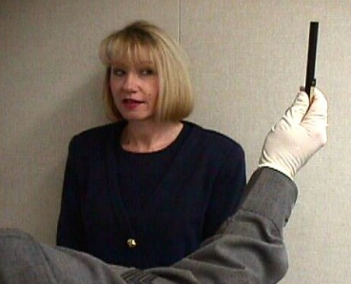
Horizontal Gaze Nystagmus
Involuntary jerking of the eyes,
occurring as the eyes gaze to the side
Notes:
C. Horizontal Gaze Nystagmus
Definition Review: Involuntary jerking of the eyes, occurring as the eyes gaze to the side.
In addition to being involuntary:
Person is usually unaware that it is happening.
Person is powerless to stop it or control it.
Key Summary Point: Alcohol and certain other drugs cause Horizontal Gaze Nystagmus.
Other drugs that can cause nystagmus are CNS Depressants, Inhalants, and Dissociative Anesthetics.

Slide 18
Categories of Nystagmus
Vestibular
Neural
Pathological Disorders and Diseases
Notes:
Categories of Nystagmus
Horizontal Gaze Nystagmus is not the only kind of nystagmus. There are other circumstances under which the eyes will jerk involuntarily.
It is important to know some of the other common types of nystagmus, to be aware of their potential impact on our field sobriety tests.
Nystagmus of several different origins may be seen. The three general categories of nystagmus are:
Vestibular
Neural
Pathological Disorders and Diseases

Slide 19
Vestibular Nystagmus
Rotational
Post Rotational
Caloric
Notes:
Vestibular Nystagmus is caused by movement or action to the vestibular system.
Point out that the vestibular system is a sense organ located in the inner ear. It provides information to the brain, and consequently to the eyes about position and movement of the head to maintain orientation and balance of the body.
Types of vestibular nystagmus:
Rotational Nystagmus occurs when the person is spun around or rotated rapidly, causing the fluid in the inner ear to be disturbed. If it were possible to observe the eyes of a rotating person, they would be seen to jerk noticeably.
Post Rotational Nystagmus is closely related to rotational nystagmus: when the person stops spinning, the fluid in the inner ear remains disturbed for a period of time, and the eyes continue to jerk.
Neither Rotational nor Post Rotational Nystagmus will interfere with the Horizontal Gaze Nystagmus test because of the conditions under which they occur.
To illustrate rotational and post rotational, swirl a half glass of water several times. Stop swirling glass, water will continue to spin for a short period of time.
Caloric Nystagmus occurs when fluid motion in the canals of the vestibular system is stimulated by temperature as by putting warm water in one ear and cold in the other.

Slide 20
Vestibular Nystagmus (Cont.)
Positional Alcohol Nystagmus
Notes:
Positional Alcohol Nystagmus (PAN) occurs when a foreign fluid, such as alcohol, that alters the specific gravity of the blood is in unequal concentrations in the blood and the vestibular system. This causes the vestibular system to respond to gravity in certain head positions, resulting in nystagmus.
In the original HGN study, research was not conducted for performing HGN on people lying down. Current research demonstrates that HGN can be performed on someone in this position.
There are two types of PAN:
PAN I - occurs when the alcohol concentration in the blood is greater than the inner ear fluid. PAN I occurs while BAC is increasing.
PAN II - occurs when the alcohol concentration in the inner ear fluid is greater than in the blood. An example of PAN is the spinning of a room when a person lies down after consuming alcohol. This occurs while BAC is decreasing.
Reference in 2010 Manual to details of this study is included in section H, 5 #33.

Slide 21
Neural Nystagmus
Optokinetic
Notes:
Nystagmus can also result directly from neural activity:
Optokinetic Nystagmus occurs when the eyes fixate on an object that suddenly moves out of sight, or when the eyes watch sharply contrasting moving images.
Examples of optokinetic nystagmus include watching strobe lights, rotating lights, or rapidly moving traffic in close proximity. The Horizontal Gaze Nystagmus test will not be influenced by optokinetic nystagmus when administered properly. During the Horizontal Gaze Nystagmus test, the suspect is required to fixate the eyes on a penlight, pencil or similar object that moves in accordance with the HGN testing procedures, thus optokinetic nystagmus will not occur. The movement of the stimulus and the fixation on the stimulus by the subject precludes this form of nystagmus from being observed by the officer.
Point out that during the Horizontal Gaze Nystagmus test, the subject is required to focus the eyes on a penlight, pencil or similar object that moves smoothly and relatively slowly across the field of view, thus optokinetic nystagmus will not occur.
When practical, remind participants to face the driver away from potential distractions that could be raised later.

Slide 22
Neural Nystagmus
Physiological
Gaze
Notes:
Physiological Nystagmus is a natural nystagmus that keeps the sensory cells of the eye from tiring. It is the most common type of nystagmus. It happens to all of us, all the time. This type of nystagmus produces extremely minor tremors or jerks of the eyes. These tremors are usually too small to be seen with the naked eye. Physiological nystagmus will have no impact on our Standardized Field Sobriety Tests, because it’s tremors are usually invisible.
Emphasize that physiological nystagmus will have no impact on our Standardized Field Sobriety Tests, because its tremors are usually invisible.
Gaze Nystagmus is a form of nystagmus that occurs when the eyes attempt to maintain visual fixation on a stimulus.

Slide 23
Gaze Nystagmus
    Horizontal
    Vertical
    Resting
Notes:
For our purposes, gaze nystagmus is separated into three types:
Horizontal
Vertical
Resting

Slide 24
Horizontal Gaze Nystagmus
Involuntary jerking of the eyes, occurring as the eyes gaze to the side
Observation of the eyes for Horizontal Gaze Nystagmus provides the first and most accurate test in the SFST Battery
It’s presence may indicate use of certain other drugs
Notes:
Horizontal Gaze Nystagmus is an involuntary jerking of the eyes, occurring as the eyes gaze to the side. It is the observation of the eyes for Horizontal Gaze Nystagmus that provides the first and most accurate test in the Standardized Field Sobriety Test battery. Although this type of nystagmus is indicative of alcohol impairment, its presence may also indicate use of certain other drugs.
Examples of other drugs are: CNS Depressants, Inhalants, and Dissociative Anesthetics such as PCP and its analogs.
Emphasize to participants that this training course is concerned with Horizontal Gaze Nystagmus and that this procedure has been validated as an accurate indicator for alcohol influence by extensive scientific research.

Slide 25
Vertical Gaze Nystagmus
Involuntary jerking of the eyes (up and down)
Occurs when the eyes gaze upward at maximum elevation
Associated with high doses of alcohol and certain other drugs
Drugs that cause VGN may cause HGN
Notes:
Vertical Gaze Nystagmus is an involuntary jerking of the eyes (up and down) which occurs when the eyes gaze upward at maximum elevation. The presence of this type of nystagmus is associated with high doses of alcohol for that individual and certain other drugs. The drugs that cause Vertical Gaze Nystagmus are the same ones that cause Horizontal Gaze Nystagmus.
There is no drug that will cause Vertical Gaze Nystagmus that may not cause Horizontal Gaze Nystagmus. If Vertical Gaze Nystagmus is present and Horizontal Gaze Nystagmus is not, it could be a medical condition.
For VGN to be recorded, it must be definite, distinct and sustained for a minimum of four seconds at maximum elevation.

Slide 26
Resting Nystagmus
Jerking of the eyes as they look straight ahead
Presence usually indicates a pathological disorder or high doses of a Dissociative Anesthetic drug such as PCP
If detected, take OFFICER SAFETY precautions
Notes:
Resting Nystagmus is referred to as a jerking of the eyes as they look straight ahead. Its presence usually indicates a pathological disorder or high doses of a Dissociative Anesthetic drug such as PCP. If detected, take precautions. (OFFICER SAFETY.)
Nystagmus may also be caused by certain pathological disorders. They include brain tumors and other brain damage or some diseases of the inner ear. These pathological disorders occur in very few people and in even fewer drivers.

Slide 27
Pathological Disorder Nystagmus
Brain tumors and other brain damage
Some inner ear diseases
Rare in the driving population
Notes:
Nystagmus may also be caused by certain pathological disorders. They include brain tumors and other brain damage or some diseases of the inner ear. These pathological disorders occur in very few people and in even fewer drivers.
Point out that nystagmus caused by pathological disorders is extremely rare in the driving population. Persons suffering from these disorders are rarely able to drive.

Slide 28
Medical Impairment
Equal pupil size
Resting nystagmus
Equal tracking
Notes:
Medical Impairment
The examinations that you conduct to assess possible medical impairment include:
Equal pupil size
Resting nystagmus
Equal tracking
Pupil size will be affected by some medical conditions or injuries. If the two pupils are distinctly different in size, it is possible that the subject:
Has a prosthetic eye
Is suffering from a head injury
Has a neurological disorder
Resting nystagmus is referred to as jerking as the eyes look straight ahead. This condition is not frequently seen. Its presence usually indicates a pathology or high doses of a drug such as a Dissociative Anesthetic like PCP.
Resting nystagmus may also be a medical problem.
Tracking ability will be affected by certain medical conditions or injuries involving the brain.
Demonstrate how to check for equal pupil size, resting nystagmus and equal tracking.
This observation is a medical assessment. If the two eyes do not track together, the possibility of a serious medical condition or injury is present.

Slide 29
Medical Impairment (Cont.)
Even though the possibility of alcohol and/or drug impairment exists, be aware of medical conditions having symptoms in common with alcohol influence.
Notes:
Point out: Even though the possibility of alcohol and/or drug impairment exists, officers should be aware of medical conditions having symptoms in common with alcohol influence.
By passing a stimulus across both eyes, you can check to see if both eyes are tracking equally. If they don't (i.e., if one eye tracks the stimulus, but the other fails to move, or lags behind the stimulus) there is the possibility of a neurological disorder.
If a person has sight in both eyes, but the eyes fail to track together, there is a possibility that the person is suffering from an injury or illness affecting the brain.
For further information on drugs other than alcohol and procedures for conducting a preliminary examination to check for medical impairment, injury or drug impairment, see the curriculum package entitled “Introduction to Drugged Driving” or “ARIDE.”

Slide 30
HGN Medical Impairment
Assessment Procedures
Check eyes for:
Equal pupil size
Resting nystagmus
Equal tracking
  If eyes do not track together, or pupils are noticeably unequal in size, medical disorders or injuries may be present
Notes:
Procedures to Assess Possible Medical Impairment
Prior to administration of HGN, the eyes are checked for equal pupil size, resting nystagmus, and equal tracking (can they follow an object together). If the eyes do not track together, or if the pupils are noticeably unequal in size, the chance of medical disorders or injuries causing the nystagmus may be present.

Slide 31
HGN Testing: Three Clues
Lack of smooth pursuit
Distinct and sustained Nystagmus at maximum deviation
Onset of Nystagmus prior to 45 degrees
Notes:
Procedures of Horizontal Gaze Nystagmus Testing: The Three Clues
The test you will use at roadside is "Horizontal Gaze Nystagmus" -- an involuntary jerking of the eyes occurring as the eyes gaze to the side. When a person is impaired by alcohol or certain drugs, some jerking will be seen if the eyes are moved far enough to the side.
Note: CNS Depressants, Inhalants, and Dissociative Anesthetics can cause HGN.
The Lack of Smooth Pursuit (Clue Number One) - The eyes can be observed to jerk or "bounce" as they follow a smoothly moving stimulus, such as a pencil or penlight. The eyes of an impaired person will not follow smoothly, i.e., a marble rolling across sand paper, or windshield wipers moving across a dry windshield.
Distinct and Sustained Nystagmus At Maximum Deviation (Clue Number Two) - Distinct and sustained nystagmus is evident when the eye is held at maximum deviation for a minimum of four seconds and continues to jerk toward the side.
Even unimpaired people may exhibit slight jerking of the eye at maximum deviation, but this will not be evident or sustained for more than a few seconds.
Onset of Nystagmus Prior To 45 Degrees (Clue Number Three) - The point at which the eye is first seen jerking. If the jerking begins prior to 45 degrees it is evident that the person has a BAC above 0.08, as shown by recent research.
The higher the degree of impairment, the sooner the nystagmus will be observable.

Slide 32
Administrative Procedures
Check for eyeglasses
Verbal instructions
Position stimulus (12-15 inches and slightly above eye level)
Check for equal pupil size and resting nystagmus
Check for equal tracking
Lack of smooth pursuit
Distinct and sustained nystagmus at maximum deviation
Onset of nystagmus prior to 45 degrees
Total the clues
Check for vertical nystagmus
Notes:
Horizontal and Vertical Gaze Nystagmus can be observed directly and does not require special equipment. You will need a contrasting stimulus for the subject to follow with their eyes. This can be a penlight or pen. The stimulus used should be held slightly above eye level, so that the eyes are wide open when they look directly at it. It should be held approximately 12 - 15 inches in front of the nose. Remain aware of your position in relation to the subject at all times.
OFFICER SAFETY IS THE NUMBER ONE PRIORITY ON ANY TRAFFIC STOP.
Administrative Procedures
Check for eyeglasses
Verbal instructions
Position stimulus (12-15 inches and slightly above eye level)
Check for equal pupil size and resting nystagmus
Check for equal tracking
Lack of smooth pursuit
Distinct and sustained nystagmus at maximum deviation
Onset of nystagmus prior to 45 degrees
Total the clues
Check for vertical nystagmus

Slide 33
HGN Procedures
Check for eyeglasses
Verbal instructions
Position stimulus
Notes:
Step 2: Verbal Instructions.
Give the subject the appropriate verbal instructions:
Point out that officers’ should note whether subject sways, wobbles, etc. while trying to balance.
Put feet together, hands at the side
Keep head still
Look at the stimulus
Follow movement of the stimulus with the eyes only
Keep looking at the stimulus until told the test is over
Emphasize that these are the major points that must be conveyed during the verbal instructions.
Step 3: Position the Stimulus.
Position the stimulus approximately 12 - 15 inches (30 - 38 cm) in front of subject's nose, and slightly above eye level to commence the test.
Resting Nystagmus may be observed at this time. Officers should note whether the subject displays Resting Nystagmus.

Slide 34
HGN Procedures (Cont.)
4. Pupil size and resting nystagmus
5. Equal tracking
Notes:
Step 4: Equal Pupil Size and Resting Nystagmus. Check for equal pupil size and resting nystagmus.
Remind the participants that if Resting Nystagmus is observed they can continue with the remainder of the test to check for other possible indicators of impairment and any possible indicators of a medical condition.
Remind participants to also check for resting nystagmus when checking for equal pupil size.
Step 5: Equal Tracking.
Check for equal tracking. Move the stimulus rapidly from center to far right, to far left and back to center.
Remind the participants that the speed of the stimulus should be approximately the same speed used as checking for the lack of smooth pursuit.
Remind the participants to make at least two complete passes in front of the eyes to check for equal tracking.
Point out that there should be a clear, distinguishable break between the check for equal tracking and lack of smooth pursuit.

Slide 35
HGN Procedures (Cont.)
Check for lack of smooth pursuit
Check for distinct and sustained nystagmus at maximum deviation
Check for onset of nystagmus prior to 45 degrees
Notes:
Step 6: Lack of Smooth Pursuit. Check the left eye for lack of the "Smooth Pursuit" clue. If the eye is observed to jerk while moving, that is one clue.
Check the right eye for lack of the "Smooth Pursuit" clue and compare.
Remind participants to make at least two complete passes in front of the eyes to check this clue.
Step 7: Check the right and left eye for the "distinct and sustained nystagmus at maximum deviation" clue. If the jerkiness is distinct and sustained, that is one clue.
Emphasize that the jerking must be definite, distinct and sustained in order to score this clue. Remind participants to check each eye at least twice for this clue.
Check the right eye for the "distinct and sustained nystagmus at maximum deviation" clue and compare.
Point out that in most cases no white should be showing in the corner of the eye when observing this clue.
Step 8: Onset of Nystagmus Prior to 45 Degrees. Check the left eye for the "onset of nystagmus prior to 45 degrees" clue. If the jerking begins prior to 45 degrees, that is one clue.
Remind participants to check each eye at least twice for this clue. Point out that, for many subjects, nystagmus clues will appear in the sequence listed.
Check the right eye for "onset of nystagmus prior to 45 degrees" clue, and compare.

Slide 36
HGN Procedures (Cont.)
9. Total the clues
10. Check for Vertical Gaze Nystagmus
Notes:
Step 9: Total the clues
Maximum number of clues possible for each eye: 3
Total maximum number of clues possible for both eyes: 6
Also, point out that the subject's performance may not be exactly identical in both eyes.
That is, as BAC increases, many people first show inability of smooth pursuit, then show distinct jerkiness at maximum deviation, and finally show an onset within 45 degrees. However, that may not always be true.
Step 10: Check for Vertical Nystagmus
It is possible that all three clues definitely will be found in one eye, while only two (or sometimes only one) will show up in the other eye. It is always necessary to check both eyes, and to check them independently. Notwithstanding, it is unlikely that the eyes of someone under the influence of alcohol will behave totally different.
Thus, if one eye shows all three clues distinctly while the other eye gives no evidence of nystagmus, the person may be suffering from one of the pathological disorders covered previously.

Slide 37
Test Interpretation
Look for three clues of nystagmus in each eye:
Lack of smooth pursuit
Distinct and sustained Nystagmus at maximum deviation
Onset of Nystagmus prior to 45 degrees
Notes:
Test Interpretation
You should look for three clues of nystagmus in each eye.
Lack of Smooth Pursuit (The eye cannot follow a moving object smoothly)
Distinct and Sustained Nystagmus at Maximum Deviation (Nystagmus is distinct and sustained when the eye is held at maximum deviation for a minimum of four seconds)
Onset of Nystagmus Prior to 45 Degrees.
Based on recent research, if you observe four or more clues it is likely that the subject's BAC is at or above 0.08. Using this criterion you will be able to classify about 88% of your subjects accurately. This was determined during laboratory and field testing and helps you weigh the various Standardized Field Sobriety Tests in this battery as you make your arrest decision.
This accuracy level was determined through the San Diego Study (“Validation of the Standardized Field Sobriety Test Battery at BACs Below 0.10 %”).

Slide 38
Three Clues of Horizontal Gaze Nystagmus
Lack of smooth pursuit
Distinct and sustained nystagmus at maximum deviation
Onset of nystagmus prior to 45 degrees
Notes:
Three Clues of Horizontal Gaze Nystagmus
It is important that participants start with the subject’s left eye first. Then check the right eye for the same clue. This procedure should be used for all three clues.
When we administer the Horizontal Gaze Nystagmus test, we look for three specific clues as evidence of alcohol influence.
We check each eye independently for each clue.
Remind the participants to check each eye twice for each clue.
For standardization, begin with the subject's left eye. Check for the first clue. Next, check right eye for same clue. Repeat this procedure for each clue starting with left eye, then right eye. Compare and document the results.
When we are checking an eye, it is good practice to administer the test by the numbers each time, to make sure that no step is overlooked.
EMPHASIZE THAT: OFFICER SAFETY IS OF KEY IMPORTANCE WHEN ADMINISTERING THESE TESTS.

Slide 39
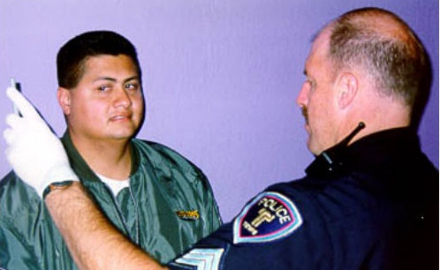
Clue Number 1
Lack of smooth pursuit
Notes:
Clue No. 1: Lack of Smooth Pursuit
The first clue requires that the subject move the eye to follow the motion of a smoothly moving stimulus.
Emphasize that subject must keep the head still and follow the stimulus with the eyes only.
The stimulus may be the eraser on a pencil, the tip of a penlight, the tip of your finger, or any similar small object.
Emphasize here that it is best to use a stimulus which contrasts with the background.
Begin by holding the stimulus vertically approximately 12 - 15 inches (30 - 38 cm) in front of the subject's nose, and slightly above eye level.
Point out that when stimulus slightly higher than eye level, subject will have to open eyes wide to focus on it. Wide open eyes make it easier to see the nystagmus.

Slide 40
Mechanics of Clue Number 1
Move object steadily at a speed that takes approximately 2 seconds to bring the eye from center to side
Make at least two complete passes in front of the eyes
Notes:
The Mechanics of Clue Number 1
It is necessary to move the object smoothly in order to check the eye’s ability to pursue smoothly.
The stimulus should be moved from center position, all the way out to the right side (checking subject's left eye) where the eye can go no further, and then all the way back across subject's face all the way out to the left side where the eye can go no further (checking subject's right eye) and then back to the center.
Demonstrate.
The object must be moved steadily, at a speed that takes approximately 2 seconds to bring the eye from center to side.
Demonstrate.
In checking for this clue, make at least two complete passes in front of the eyes.
Demonstrate.
If you are still not able to determine whether or not the eye is jerking as it moves, additional passes may be made in front of the eyes.

Slide 41
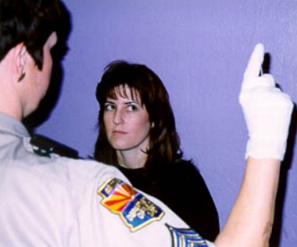
Clue Number 2
Distinct and Sustained Nystagmus
at Maximum Deviation
Notes:
Clue No. 2: Distinct and Sustained Nystagmus at Maximum Deviation
Once you have completed the check for lack of smooth pursuit, you will check the eyes for distinct and sustained nystagmus when the eye is held at maximum deviation, beginning with the subject's left eye.
The Mechanics of Clue Number 2
Once again, position the stimulus approximately 12 - 15 inches (30 - 38 cm) in front of subject's nose and slightly above eye level.
Demonstrate.
Move the stimulus off to the right side (checking subject's left eye) until the eye has gone as far as possible.
Demonstrate holding the stimulus steadily off to the side.
Hold the stimulus steady at that position for a minimum of four (4) seconds, and carefully watch the eye.
Point out that four (4) seconds is a relatively long period of time. You cannot simply hold the eye to the side for an instant, and expect to observe distinct jerking.
Then, move the stimulus back across the subject's face all the way out to the left side (subject's right eye).

Slide 42
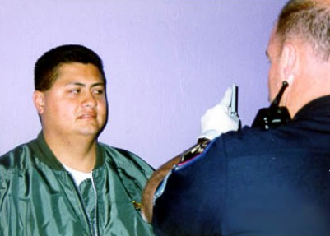
Clue Number 3
Onset of Nystagmus Prior to 45 Degrees
Notes:
Clue No. 3: Onset of Nystagmus Prior to 45 Degrees
Once again, position the stimulus approximately 12 - 15 inches (30 - 38 cm) in front of subject's nose and slightly above eye level.
EMPHASIZE OFFICER SAFETY.
The angle of onset of nystagmus is simply the point at which the eye is first seen jerking.
Examples: With someone at a very high BAC (0.20+), the jerking might begin almost immediately after the eye starts to move toward the side. For someone at 0.08 BAC, the jerking might not start until the eye has moved nearly to the 45 degree angle.
Generally speaking, the higher the BAC, the sooner the jerking will start as the eye moves toward the side.
If the jerking begins prior to 45 degrees, that person’s BAC could be 0.08 or above.
REMIND PARTICIPANTS THAT THE ADMINISTRATION OF HGN IS NOT TO BE USED TO ESTIMATE SPECIFIC BAC LEVEL.

Slide 43
45 Degree Template
45
o
8-43
Notes:
Training Aid: The 45 Degree Template
A training aid has been provided to help you practice estimating a 45 degree angle.
Instruct participants to remove their copies of the template from their participant manuals which is located at the back of Session 8 in Attachments.
The outline of a square, with its diagonal line, gives us a 45 degree angle.
This outline, or template, is provided for practice only.
It is not to be used with actual DWI subjects.
Demonstrate proper placement of the template.
To use the template, have your training partner hold the corner of the square under the nose.
Demonstrate placement of the pencil or penlight.

Slide 44
45 Degree Template (Cont.)
45
o
8-44
Notes:
When you line up your stimulus with the diagonal line, your partner will be looking along a 45 degree angle.
Participant practice with 45 degree Template. Practice in groups of two or three, taking turns.
Instruct participants to begin by lining the stimulus up with the diagonal, so they can become familiar with the position of an eye at a 45 degree angle.
Point out the amount of white showing in the corner of an eye at 45 degrees.
Next, instruct each participant to attempt to locate the 45 degree point without using the template, then to raise the template to check the accuracy of the estimate.

Slide 45
Participant Practice
45
o
8-45
Notes:
Coaching and Critiquing Participants' Practice
Common initial mistakes to note and correct:
Failing to check for white in the corner of the eye.
Tending to stop short of 45 degrees.
Failing to check alignment of object with shoulder.
Participant led Demonstration
Choose a participant who appears to be doing a good job in estimating a 45 degree angle, and have the participant come forward to demonstrate to the class.
Resume participant practice, and allow it to continue until all participants appear reasonably proficient in carrying out the mechanics of Clue No. 3.

Slide 46
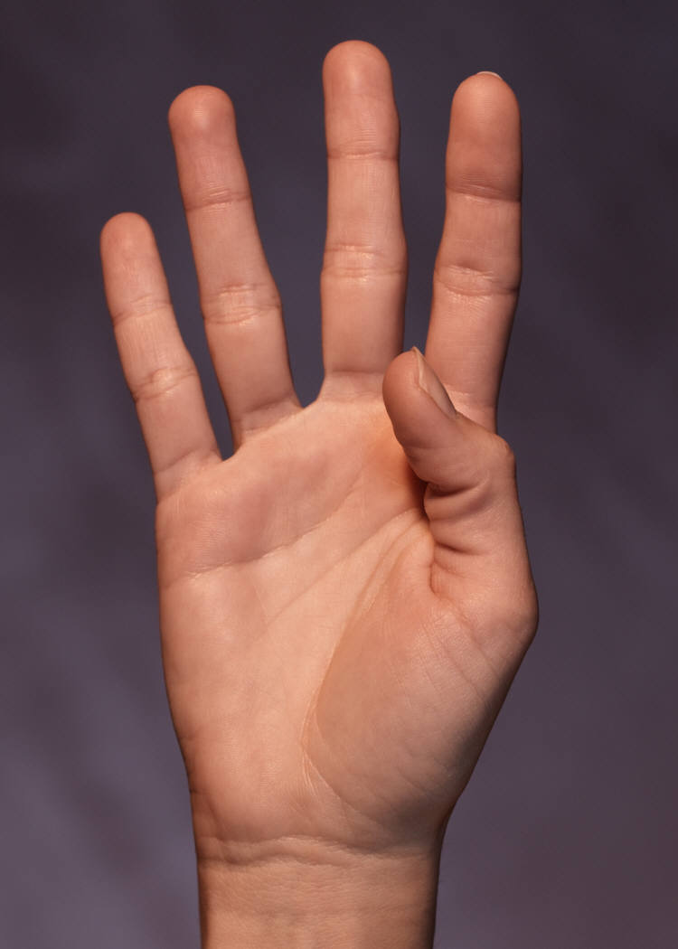
Horizontal Gaze Nystagmus
Test Criterion
4 or more clues indicates
BAC above 0.08 (88% accurate)
8-46
Notes:
Test Interpretation
Based upon the original developmental research into Horizontal Gaze Nystagmus, the criterion for this test is 4.
If a person exhibits at least 4 out of the possible 6 clues, the implication is a BAC above 0.08.
Using this criterion, the test is 88% accurate.
Remind participants that the SFST field evaluation study conducted in San Diego in 1998 indicated that “HGN alone provides valid indications to support arrest decisions at 0.08 BAC.”

Slide 47
Horizontal Gaze Nystagmus
Test Demonstration
8-47
Notes:
Test Demonstration
Choose a participant to serve as a demonstration subject.
Advance to next slide to conduct demonstration.

Slide 48
Administrative Procedures
Check for eyeglasses
Verbal instructions
Position stimulus (12-15 inches and slightly above eye level)
Check for equal pupil size and resting nystagmus
Check for equal tracking
8-48
Notes:
Conduct a complete test of that participant subject, articulating every step in the testing sequence.
Upon completion of the demonstration, solicit participants' questions concerning Horizontal Gaze Nystagmus.
If time permits, conduct another complete demonstration of HGN, using another participant.
8-48

Slide 49
Administrative Procedures (Cont.)
Lack of smooth pursuit
Distinct and sustained nystagmus as maximum deviation
Onset of nystagmus prior to 45 degrees
Total the clues
Check for vertical nystagmus
8-49
Notes:
8-49

Slide 50
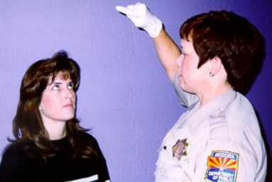
Vertical Gaze Nystagmus
8-50
Notes:
D. Vertical Gaze Nystagmus
The Vertical Gaze Nystagmus test is simple to administer. During the Vertical Gaze Nystagmus test, look for jerking as the eyes move up and are held for a minimum of four seconds at maximum elevation.
Position the stimulus horizontally, about 12 - 15 inches in front of the subject's nose.
Instruct the subject to hold the head still, and follow the object with the eyes only.
Raise the object until the subject's eyes are elevated as far as possible.
Hold for a minimum of four seconds.
Watch closely for evidence of the eyes jerking upward.
Point out that vertical nystagmus was not examined in the original research that led to the validation of the Standardized Field Sobriety Test battery (Horizontal Gaze Nystagmus, Walk and Turn and One Leg Stand).
Select a participant or another instructor to serve as a subject and demonstrate the vertical nystagmus test.

Slide 51
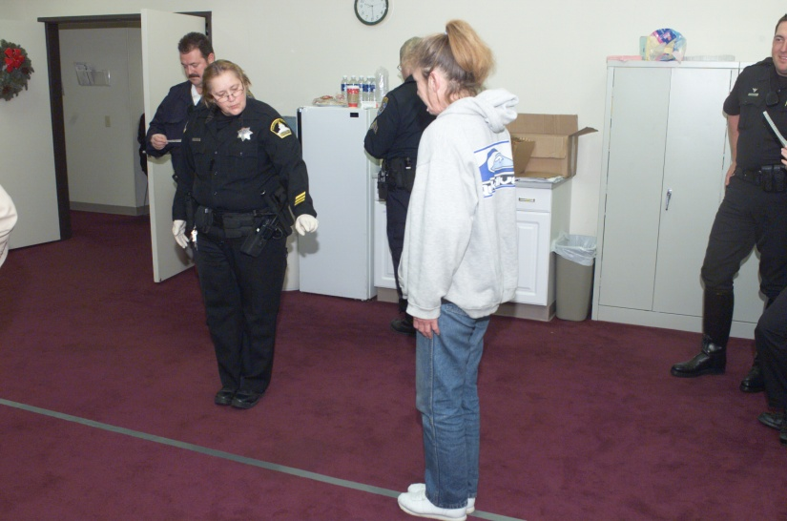
Walk and Turn
Divided Attention Test
Mental Task and Physical Task
Instructions stage
Walking stage
8-51
Notes:
E. Walk and Turn
Test Stages
Like all divided attention tests, Walk and Turn has two stages.
They are:
instructions stage
walking stage
Both stages are important, because they can affect the subject's overall performance on the test.

Slide 52
Safety Precautions
Keep subject on left side during demonstrations
Never turn back on subject
Be aware of surroundings
8-52
Notes:
Procedures for Walk and Turn Testing
Remind participants of officer safety precautions:
Keep subject on left side when initiating demonstrations
Never turn back on subject
Aware of surroundings (environment)
Emphasize that the Officer should not turn his/her back to the subject for safety reasons.

Slide 53
Administrative Procedures
Instructions Stage
Verbal instructions:
  Assume heel-to-toe stance
  Arms down at sides
  Don’t start until told
8-53
Notes:
Instructions Stage: Initial Positioning and Verbal Instructions
For standardization in the performance of this test, have the subject assume the heel-to-toe stance by giving the following verbal instructions, accompanied by demonstrations:
Place your left foot on the line (real or imaginary).
Demonstrate placement of left foot.
Place your right foot on the line ahead of the left foot, with the heel of your right foot against the toe of the left foot.
Demonstrate placement of both feet.
Place your arms down at your sides.
Demonstrate placement of arms at sides.
Maintain this position until I have completed the instructions. Do not start to walk until told to do so.
Do you understand the instructions so far? (Make sure subject indicates understanding.)
Emphasize that officer must receive some affirmative response before continuing.

Slide 54
Administrative Procedures
Walking Stage
Nine heel-to-toe steps, turn, nine heel-to-toe steps
Turn procedures:
  Turn around on line
  Several small steps
8-54
Notes:
Demonstrations and Instructions for the Walking Stage
A straight line must be available for this and subsequent demonstrations.
A 10 - 12 foot strip of masking tape on the floor of the classroom will prove suitable.
Explain the test requirements by giving instructions, accompanied by demonstrations:
When I tell you to start, take nine heel-to-toe steps on the line, turn, and take nine heel-to-toe steps down the line.
Demonstrate a minimum of three heel-to-toe steps.
When you turn, keep the front (lead) foot on the line, and turn by taking a series of small steps with the other foot, like this.
Demonstrate the turn and a minimum of three heel-to-toe return steps
While you are walking, keep your arms at your sides, watch your feet at all times, and count your steps out loud.
Once you start walking, don't stop until you have completed the test.
Do you understand the instructions? (Make sure subject understands.)
Instruct the person to begin the test.
Instructor's demonstration (repeat if necessary).
Instruct the participants that there may be instances when the officer may have to remind the suspect that the first step taken from the heel-to-toe position is step one.

Slide 55
Administrative Procedures (Cont.)
While walking:
  Keep watching feet
  Arms down at sides
  Count steps out loud
  Don’t stop during walk
8-55
Notes:
While walking:
Keep watching feet
Arms down at sides
Count steps out loud
Don’t stop during walk

Slide 56
Walk and Turn Test Clues
Cannot keep balance while listening to instructions
8-56
Notes:
Test Interpretation
You may observe a number of different behaviors when a subject performs this test. Original research demonstrated that the behaviors listed below are likely to be observed in someone with a BAC at or above 0.08. Look for the following clues each time this test is given:
Cannot keep balance while listening to the instructions. Two tasks are required at the beginning of this test. The subject must balance heel-to-toe on the line, and at the same time, listen carefully to the instructions. Typically, the person who is impaired can do only one of these things. The subject may listen to the instructions, but not keep balance. Record this clue if the subject does not maintain the heel-to-toe position throughout the instructions. (Feet must actually break apart or step off the line.) Do not record this clue if the subject sways or uses the arms to balance but maintains the heel-to-toe position.
Instructor may break away from the heel-to-toe stance at this point.
Demonstrate actions that constitute “Cannot keep balance while listening to instructions", and demonstrate other actions that do not justify recording this clue.

Slide 57
Walk and Turn Test Clues (Cont.)
Starts too soon
Stops while walking
Does not touch heel-to-toe
8-57
Notes:
Starts too soon. The impaired person may also keep balance, but not listen to the instructions. Since you specifically instructed the subject not to start walking "until I tell you to begin," record this clue if the subject does not wait.
Emphasize that this clue can't be recorded unless subject was told not to start walking until directed to do so.
Stress to the participants that these first two clues, like all clues in this test, can be accumulated only once.
Demonstrate.
Stops while walking. The subject stops while walking. Do not record this clue if the subject is merely walking slowly.
Emphasize that it is because of this clue that it is important to inform the subject not to stop walking once the test begins.
Does not touch heel-to-toe. The subject leaves a space of more than one half inch between the heel and toe on any step.
Point out that a gap of at least one half inch is necessary to record this clue.

Slide 58
Walk and Turn Test Clues (Cont.)
Steps off line
Uses arms to balance
Improper turn
Incorrect number of steps
8-58
Notes:
Steps off the line. The subject steps so that one foot is entirely off the line.
Uses arms to balance. The subject raises one or both arms more than 6 inches from the sides in order to maintain balance.
Point out that a movement of the arms of six or more inches from the side is required to record this clue.
Demonstrate each of these clues.
Point out that it is often possible to note two of these clues simultaneously. Examples: (Demonstrate)
Improper turn. The subject removes the front foot from the line while turning. Also record this clue if the subject has not followed directions as instructed, i.e., spins or pivots around or loses balance while turning.
Note: There may be times when the suspect takes a wrong number of steps or begins the heel-to-toe walk with the wrong foot resulting in a turn on the right foot instead of the left. If this occurs the suspect would normally be assessed a clue for an incorrect number of steps and not assessed a clue for an improper turn if the turn was made using a series of small steps as instructed and the suspect did not lose his/her balance while attempting the turn. This scoring is consistent with the original research and training conducted the Southern California Research Institute and with the administration and scoring of the Walk and Turn test in the San Diego Field Study.
Demonstrate various ways of turning incorrectly (i.e., pivots, spins).
Incorrect number of steps. Record this clue if the subject takes more or fewer than nine steps in either direction.
Emphasize that it is the number of steps that the subject physically takes that matters here. Mistakes in the verbal count do not justify recording this clue.

Slide 59
Walk and Turn Test Clues Summary
SFSTs are a tool to assist you in seeing visible signs of impairment and are not a pass/fail test
8-59
Notes:
If subject can't do the test, record observed clues and document the reason for not completing the test, e.g. subject’s safety.
Emphasize that officers should be prepared to explain in court why the subject could not complete the test.
Remember that the SFSTs are a tool to assist you in seeing visible signs of impairment and are not a pass/fail test.
Subject gets into a "leg lock" position (legs crossed, unable to move.)
If the subject has difficulty with the test (for example, steps off the line), Continue from that point, not from the beginning. This test may lose its sensitivity if it is repeated several times.
Observe the subject from a safe distance and limit your movement which may distract the subject during the test. Always consider officer safety.

Slide 60
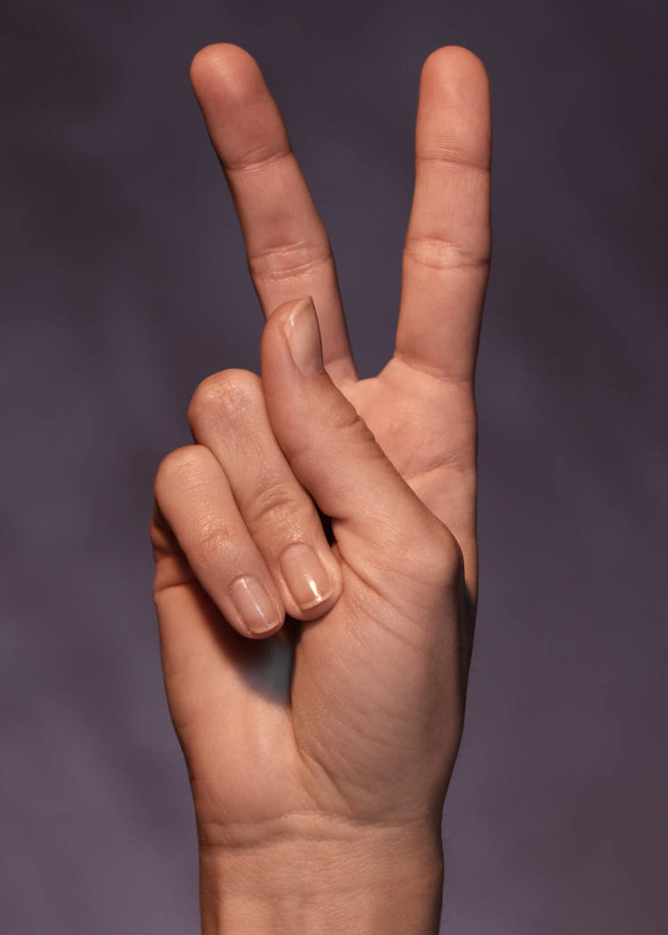
Walk and Turn Test Criterion
2 or more clues indicates BAC
at or above 0.08 (79% accurate)
8-60
Notes:
Based on recent research, if the subject exhibits two or more clues on this test or fails to complete it, classify the subject's BAC as at or above 0.08. Using this criterion, you will be able to accurately classify 79% of your subjects.
This accuracy level was determined through the San Diego Study (“Validation of the Standardized Field Sobriety Test Battery at BACs Below 0.10 %”).
Review of Divided Attention Definition
Walk and Turn is a field sobriety test based on the important concept of divided attention.
Pose this question: "What driving skills are assessed during the Walk and Turn test?” Lead the discussion, as these items were previously identified in Session 7.
The test requires the subject to divide attention among mental tasks and physical tasks.
The mental tasks include comprehension of verbal instructions; processing of information; and, recall of memory.
The physical tasks include balance and coordination; the subject is required to maintain balance and coordination while standing still, walking, and turning.

Slide 61
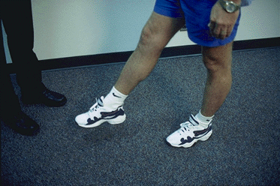
One Leg Stand
Divided Attention Test
Mental Task and Physical Task
Instructions stage
Balance and counting stage
8-61
Notes:
F. One Leg Stand
Remind participants that prior to administering this test to check if the subject has any physical problems or disabilities.
Test Stages
Like all divided attention tests, One Leg Stand has two stages.
They are:
Instructions stage
Balance and counting stage
Both stages are important, because they can affect the subject's overall performance on the test.

Slide 62
Administrative Procedures
Instructions stage:
  Stand straight, feet together
  Keep arms at sides
  Maintain position until told otherwise
8-62
Notes:
Instructions Stage: Initial Positioning and Verbal Instructions
Initiate the test by giving the following instructions, accompanied by demonstrations.
Please stand with your feet together and your arms down at the sides, like this.
Demonstrate placement of both feet and placement of arms at sides.
Do not start to perform the test until I tell you to do so.
Do you understand the instructions so far?
Emphasize that officer must receive some affirmative response before continuing.

Slide 63
Administrative Procedures (Cont.)
Balance and counting stage:
  Raise either leg
  Keep raised foot approximately six inches (15 cm) off ground
  Keep both legs straight and arms at your side
  Keep eyes on raised foot
  Count out loud in the following manner: “one thousand one, one thousand two, one thousand three and so on”, until told to stop
8-63
Notes:
Demonstrations and Instructions for the Balance and Counting Stage
Explain the test requirements, using the following verbal instructions, accompanied by demonstrations:
When I tell you to start, raise either leg with the foot approximately six inches off the ground.
Demonstrate this position.
Keep both legs straight and your arms at your side.
While holding that position, count out loud in the following manner: “one thousand one, one thousand two, one thousand three,” and so on until told to stop.
Demonstrate a count, as follows: "one thousand one, one thousand two, one thousand three, etc." Officer should not look at his foot when conducting the demonstration - OFFICER SAFETY.

Slide 64
One Leg Stand Test Clues
Sways while balancing
Uses arms to balance
Hopping
Puts foot down
8-64
Notes:
Test Interpretation
You may observe a number of different behaviors when a subject performs this test. The original research found the behaviors listed below are the most likely to be observed in someone with a BAC at or above 0.08. When administering the One Leg Stand test, we look for certain specific behaviors. Each behavior or action is considered one clue. There is a maximum number of 4 clues on this test. Look for the following clues each time the One leg Stand test is administered.
The subject sways while balancing. This refers to side to side or back and forth motion while the subject maintains the one leg stand position.
Emphasize that swaying means a distinct, noticeable side to side or front to back movement of the elevated foot or of the subject's body.
Slight tremors of the foot or body should not be interpreted as swaying.
Demonstrate swaying.

Slide 65
One Leg Stand Test Criterion
2 or more clues indicates BAC
at or above 0.08 (83% accurate)
8-65
Notes:
Based on recent research, if an individual shows two or more clues or fails to complete the One Leg Stand, there is a good chance the BAC is at or above 0.08. Using that criterion, you will accurately classify 83% of the people you test as to whether their BAC's are at or above 0.08.
This accuracy level was determined through the San Diego Study (“Validation of the Standardized Field Sobriety Test Battery at BACs Below 0.10 %”).
Observe the subject from a safe distance and minimize movement during the test so as not to interfere. If the subject puts the foot down, give instructions to pick the foot up again and continue counting from the point at which the foot touched the ground. If the subject counts very slowly, terminate the test after 30 seconds.
Review of Divided Attention Definition
One Leg Stand is another field sobriety test that employs divided attention.
The subject's attention is divided among such simple tasks as balancing, listening, and counting out loud.
Although none of these is particularly difficult in itself, the combination can be very difficult for someone who is impaired.

Slide 66
Taking Field Notes on the SFSTs
IV Pre-Arrest Screening
Left Right
Horizontal Gaze Nystagmus
Lack of smooth pursuit
Dist. & sust. nystagmus at maximum deviation
Nystagmus onset prior to 45 degrees
Vertical Gaze Nystagmus Y or N (circle one)
Other _________________________________
Yes No
Yes No
Yes No
Equal Tracking
Equal Pupils
Resting Nyst.
Walk-and-Turn
Instructions Stage
Cannot keep balance
Starts too soon
Walking Stage
Stops walking
Misses heel-toe
Steps off line
Raises arms
Actual steps taken
First Nine Steps Second Nine Steps
Improper Turn (Describe)
Cannot Do Test (Explain)
Other:
8-66
Notes:
G. Taking Field Notes on the Standardized Field Sobriety Tests
For purposes of the arrest report and courtroom testimony, it is not enough to report the number of clues on the three tests.
The numbers are important to the police officer in the field, because they help determine whether there is probable cause to arrest.
But to secure a conviction, more descriptive evidence is needed.
The officer must be able to describe how the subject performed on the tests, and what the subject did.
The standard note taking guide is designed to help develop a clear description of the subject's performance on the tests.
Instruct the participants to take out a copy of the note taking guide to follow along with this discussion.

Slide 67
Medical Assessment
Equal Tracking
Equal Pupils
Resting Nyst.
Yes No
Yes No
Yes No
8-67
Notes:
Equal Pupils □ Yes □ No
Equal Tracking □ Yes □ No
Resting Nystagmus □ Yes □ No
Other ____________________________
Emphasize that officers must be careful to place their check marks in the columns corresponding to the eye actually being checked.

Slide 68
Horizontal Gaze Nystagmus
Left Right
Horizontal Gaze Nystagmus
Lack of smooth pursuit
Dist. & sust. nystagmus at maximum deviation
Nystagmus onset prior to 45 degrees
Vertical Gaze Nystagmus(circle one) Y or N Other _________________________________
8-68
Notes:
Sections of the note taking guide will be on display throughout the discussion.
Complete the entire procedure for both eyes, checking "yes" or "no" for each clue.
Check box ✓ if the clue is present.
For standardization, test the subject's left eye first.
Then, check for the same clue in the right eye.
If clue is not present, leave box blank.
After both eyes have been completely checked, total the number of HGN clues observed.
Complete the check for vertical gaze nystagmus
If present, circle Y. If not present, circle N.
In the section labeled "other", record any facts, circumstances, conditions or observations that may be relevant to this procedure.

Slide 69
Walk and Turn
Walk-and-Turn
Instructions Stage
Cannot keep balance
Starts too soon
Walking Stage
Stops walking
Misses heel-toe
Steps off line
Raises arms
Actual steps taken
First Nine Steps Second Nine Steps
Improper Turn (Describe)
Cannot Do Test (Explain)
Other:
8-69
Notes:
This slide will be left on display throughout the discussion of Walk and Turn scoring.
The section on the Walk and Turn test appears at the top of the guide's back side.
First two clues are checked only during the instructions stage.
8-69

Slide 70
One Leg Stand Field Notes
One Leg Stand:
R
L
L
R
L R
Sways while balancing
Uses arms to balance
Hopping
Puts foot down
Type of Footwear: ________________
Other: __________________________
8-70
Notes:
This slide will be left on display throughout the discussion of one leg stand clue.
Type of Footwear _________________
Record the subject's performance separately.
For each clue, record how often it appears with a (√) check mark.
Point out that, by recording when things happen as well as what happens, a more descriptive arrest report can be prepared.

Slide 71
Test Your Knowledge
Walk and Turn is an example of _____ field sobriety test.
The Walk and Turn requires a real or imaginary line and ______________
During the _____ stage of the Walk and Turn, the suspect is required to count out loud.
8-71
Notes:
TEST YOUR KNOWLEDGE
INSTRUCTIONS: Complete the following sentences.
Walk and Turn is an example of a divided attention field sobriety test.
The Walk and Turn requires a real or imaginary line and the suspect to take nine heel-to-toe steps in a straight line
During the walking stage of the Walk and Turn, the subject is required to count out loud.

Slide 72
Test Your Knowledge (Cont.)
Based upon the San Diego study, the Walk and Turn test can determine whether a subject’s BAC is above or below 0.08, _____ % of the time
In the Walk and Turn test, a subject who steps off the line during the first 9 steps and once again during the second 9 steps and who raises arms for balance twice during the second 9 steps has produced _____ distinct clue(s).
8-72
Notes:
Based upon the San Diego study, the Walk and Turn test can determine whether a subject's BAC is above or below 0.08, 79 % of the time.
In the Walk and Turn test, a subject who steps off the line during the first 9 steps and once again during the second 9 steps and who raises arms for balance twice during the second nine steps has produced two distinct clue(s).

Slide 73
Test Your Knowledge (Cont.)
The Walk and Turn test has ____________ possible clues.
During the _____ stage of the One Leg Stand test the subject must maintain balance while standing on one foot
The One Leg Stand test requires that the subject keep the foot raised for _____ seconds.
8-73
Notes:
The Walk and Turn test has 8 possible clues.
During the balance and counting stage of the One leg Stand test the subject must maintain balance for 30 seconds.
The One Leg Stand requires that the subject keep the foot elevated for 30 seconds.

Slide 74
Test Your Knowledge (Cont.)
Based upon the San Diego study, the One Leg Stand test can determine whether a subject’s BAC is above or below 0.08, _____ % of the time
In the One Leg Stand test, a subject who sways has produced _____ clue(s)
In the One Leg Stand test, a subject who raises arms, hops, and puts foot down has produced _____ clue(s).
8-74
Notes:
Based upon the San Diego study, the One Leg Stand test can determine whether a subject's BAC is above or below 0.08, 83 % of the time.
In the One Leg Stand test, a subject who sways has produced one clue(s).
In the One leg Stand test, a subject who raises arms, hops, and puts foot down has produced three clue(s).

Slide 75
Test Your Knowledge (Cont.)
The maximum number of clues for Horizontal Gaze Nystagmus that can appear in one eye is_____.
Based upon the San Diego study, the HGN test can determine whether a subject’s BAC is above 0.08, _____ % of the time.
The third clue of HGN is an onset of nystagmus prior to _____ degrees.
8-75
Notes:
The maximum number of clues for Horizontal Gaze Nystagmus that can appear in one eye is three .
Based upon the San Diego study, the Horizontal Gaze Nystagmus test can determine whether a subject's BAC is above 0.08, 88 % of the time.
The third clue of HGN is an onset of nystagmus prior to 45 degrees.

