Slide 1
Introduction to Field Sobriety Testing
Presented by William Maze

Slide 2
I need a volunteer
from the audience!

Slide 3
What makes a field sobriety test valid and valid for what?
Does it accurately discriminate impaired motorists from sober motorists?
Should these tests be used for probable cause? Circumstantial evidence? Direct evidence?
Think about Daubert and read US v Horn, 185 F Supp 530 (2002)

Slide 4
The Big Studies
1977
1981
1983
Florida
Colorado
San Diego

Slide 5
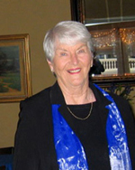
Dr. Marcelline Burns
Research psychologist
Co-founder of the Southern California Research Institute in Los Angeles
Author: Medical-Legal Aspects of Drugs
Will NOT release her DATA!!!

Slide 6
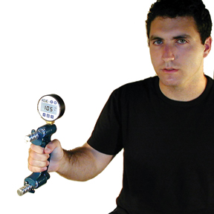
“TESTS”
Grip strength
Maze tracing
Telegraph key (10 seconds tapping)
Tongue Twisters (“methodist, episcopal, sophisticated statistics.”)
Two-Point Tactile Discrimination
Color-number naming
Serial Performance

Slide 7
WAT, OLS, & NOT HGN
1977 study formed 3 test battery
Familiar "Walk and Turn" and "One Leg Stand"
Introduced "Alcohol Gaze Nystagmus"

Slide 8
"Lies, damned lies, and statistics"
The Walk and Turn is 68% accurate.
The One Leg Stand is 65% accurate.
The AGN is 77% accurate.

Slide 9
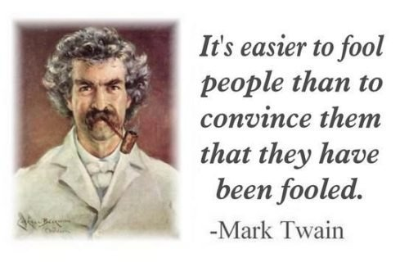

Slide 10
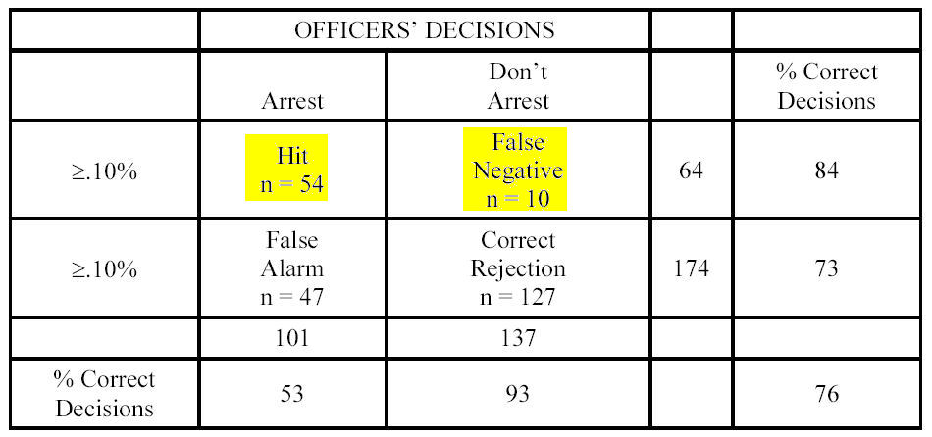
54/64=.84375
Therefore, the tests are 84% accurate, right?
If you arrest everyone: 64/64=.100

Slide 11
“As a rule, a police officer is reluctant to arrest a driver unless there is a high degree of certainty that the mandatory chemical test (breath, blood or urine) will yield a BAC reading of .10% or higher. Not only is it costly in officer time and effort to transport and test a driver who cannot be booked, it also leads to charges of harassment and generates bad community relations. These considerations certainly contribute to an over-representation among arrested drivers of those individuals whose BAC is quite high and for whom there is less uncertainty regarding impairment.” –1977 Study

Slide 12
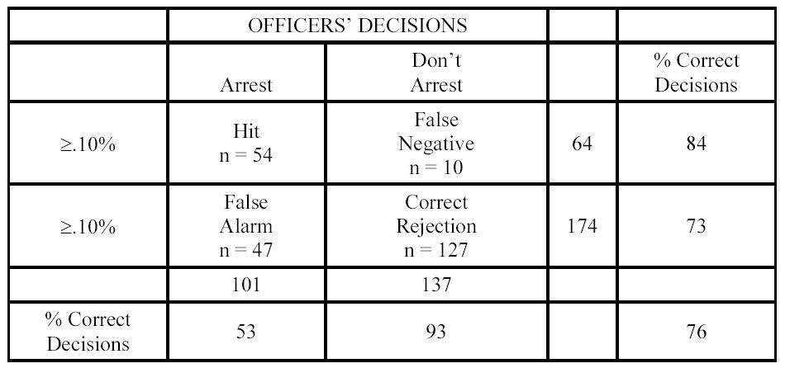
“[N]ote that the officers indicated they would have arrested 101 persons, 47 of whom had BACs below .10%. Obviously, an error rate of 47% in making arrests is not acceptable. Actually, officers in the field are reluctant to err in the direction of false alarms, and observations indicate that the most common error probably is a false negative.”

Slide 13
Officer Inexperience?
Police officer-examiners were recruited from Los Angeles area agencies and were selected to represent a broad spectrum of experience with DWI testing. This ranged from relatively new officers with less than 200 DWI arrests to veteran officers with as many as 2000 arrests.

Slide 14
“[I]ndividual differences in skill and in response to alcohol which underlie these misclassifications inevitably will be troublesome for a quantified test battery. A case in point is the male participant, age 28, whose drinking practices categorized him as a heavy drinker. He was of muscular build and appeared to be in top physical condition. His peak BAC reading was .147%, but there was no sign of intoxication in test performance, speech, or appearance. At the other extreme, a female, age 63, appeared to be intoxicated at .067% BAC, and could not perform the balance or walking tests. She is a light drinker, and she is arthritic.”

Slide 15
1981 Study
10 Police officers
297 Participants – One mysteriously leaves
BAC ranged from 0.00 to 0.18
Introduced standardized testing
AGN is replaced by “gaze nystagmus”
Claimed 81% accurate for >.10 BAC
Claimed interrater reliability and test-retest reliability of .60 to .80

Slide 16
Important Stuff!
BAC were targeted at .00, .05, .11, and .15
79% should have been clearly sober or clearly intoxicated

Slide 17
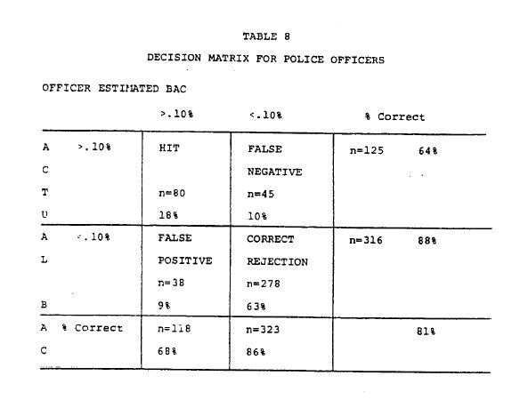
38/118 = 32% FALSE ARRESTS AT .00 and .05

Slide 18
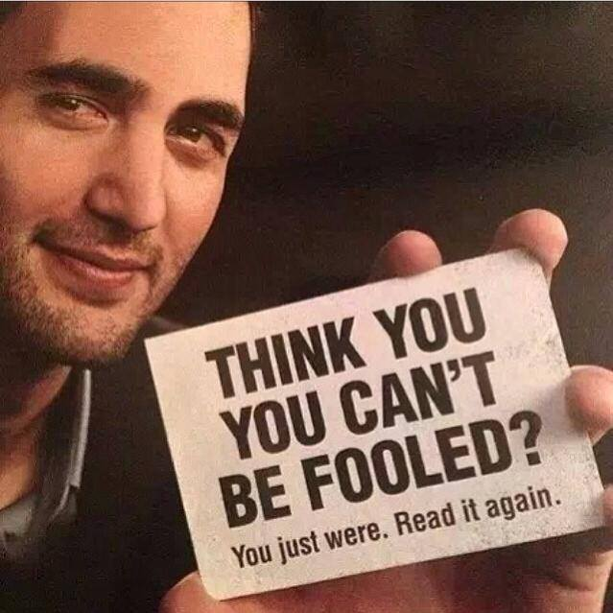
1981 Study
18 percent of the subjects who had no alcohol in their system were misjudged by the officers to be impaired.

Slide 19
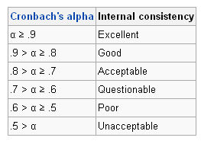
Interrater and test-retest reliability .60 to .80

Slide 20
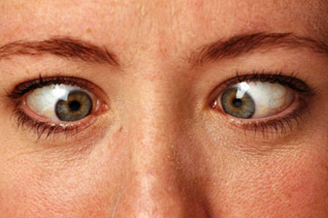
Gaze Nystagmus in 1981 (No longer AGN and not HGN)
Check for onset at 45 Degrees
Second pass is 2 seconds out looking for lack of smooth pursuit and nystagmus at maximum deviation
First pass is 4 seconds out looking at the eye for onset, then the other eye at 4 seconds
Checks eyes only twice

Slide 21
1983 Study
Field Validation - Use of FST battery in standardized fashion
Washington DC, Arlington, Maryland and North Carolina
NC data does not appear in many sections

Slide 22
Maryland Super Troopers
Maryland State Police, unlike all other police agencies, reported accuracy rates of 92%, 94% and 96%, while everyone else admitted to false arrests around 25-28%
WAT boasted a 53% accuracy (or, in plain English, a 47% false arrest rate)
Study concludes that WAT + GN = 92% accuracy

Slide 23
1983 to 1986: The Rise of HGN
Gregory W. Good & Arol R. Augsburger, Use of Horizontal Gaze Nystagmus as a Part of Roadside Sobriety Testing, 63 Am. J. of Optometry & Physiological Optics 467, 469 (1986).
Two optometrists at Ohio State University report 4 or more clues on HGN 92% accurate

Slide 24
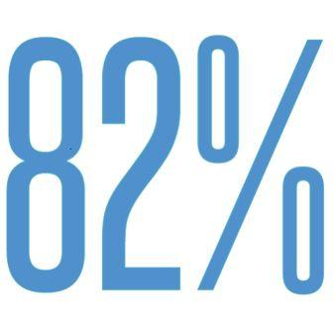
Good & Augsburger
4+ Clues = Over .10
92%
4+ Clues ≠ Over .10
82%

Slide 25
Colorado Study (1995)
Exaggerated Claims
Hidden Data in Study
NHTSA claims the SFST battery is 93% accurate
The average blood alcohol content of studied motorists was .15
12% of people under .05 failed the HGN test.

Slide 26
Florida (1997): 95% Accurate!
18% of sober people show 5 or 6 clues on HGN and upwards of 50% fail the test with 4 or more clues
At least 32% of sober people failed the OLS.
76% of sober motorists failed the WAT with two or more clues!

Slide 27
San Diego .08 Validation (1998)
Claims 91% accurate
Average BAC was, as in Florida and Colorda, .15, even though the study was intended to validate .08
False arrests were six times more likely than false releases using PBTs

